Slide 1
How Advertisements influence our minds and purchases?
By Zain, Farooq, Abdullah, Waseem & Zaeem

Slide 2

Advertisement?
Notes:
a notice or announcement in a public medium promoting a product, service, or event or publicizing a job vacancy. a person or thing regarded as a means of recommending something

Slide 3
Brief History of Advertisement

Slide 4
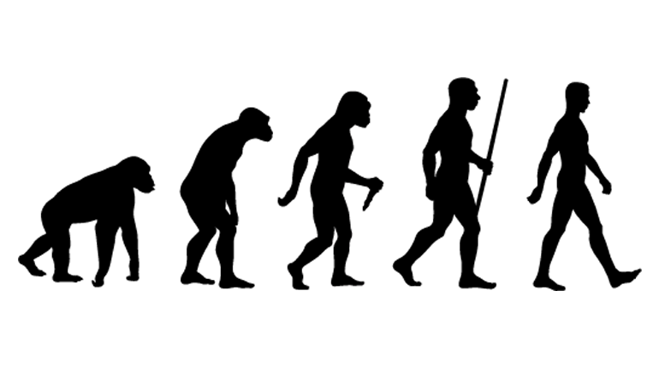
As old as human conditions

Slide 5
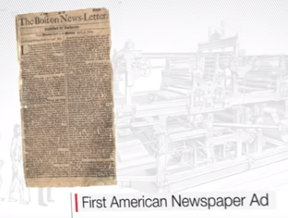

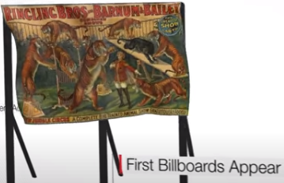
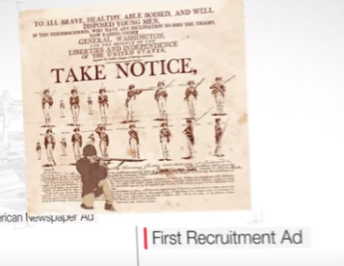
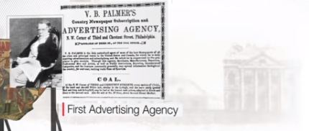
1704
1776
1835
1843
1908

Slide 6
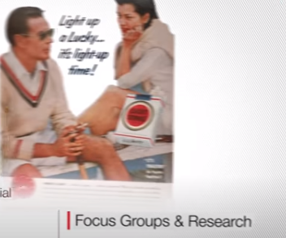
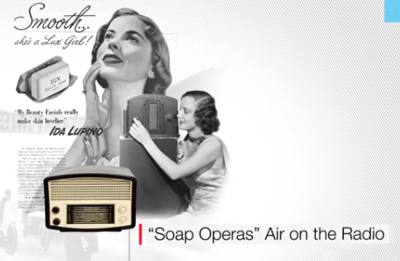
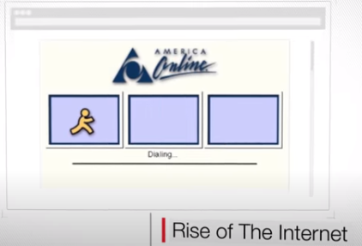
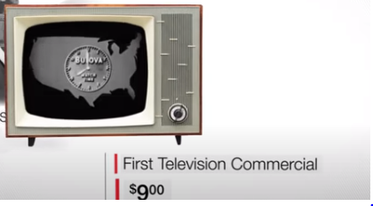
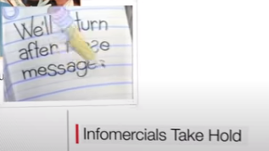
1920
1941
1960
1980
2000

Slide 7



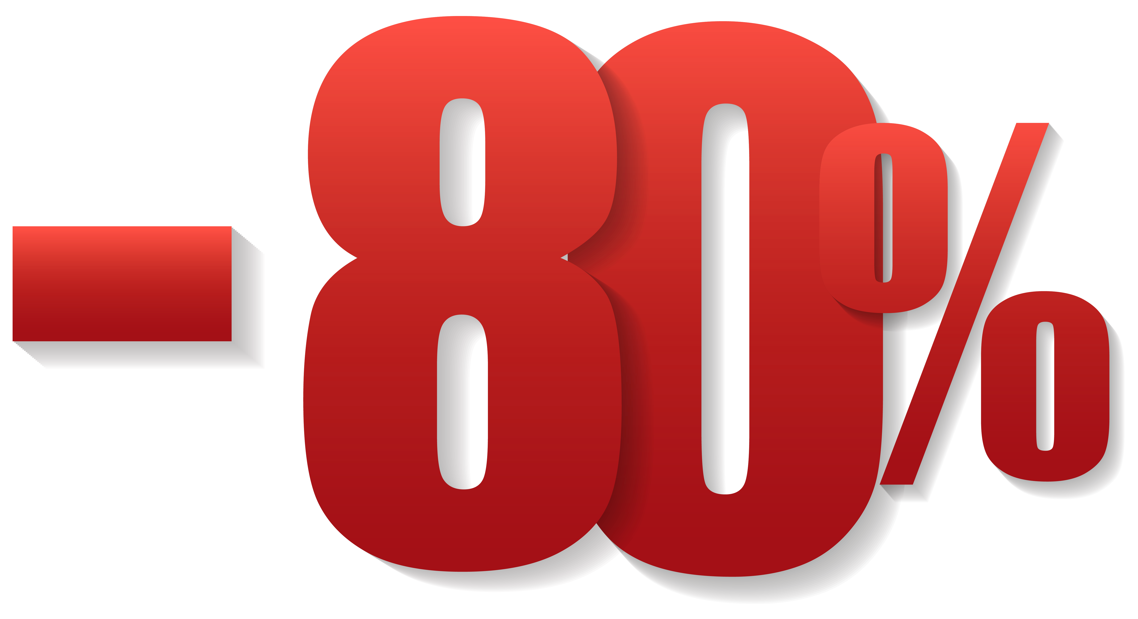
How Ads persuade you?

Slide 8
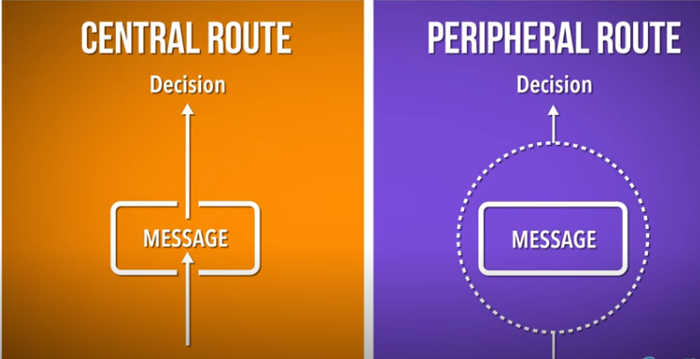
Elaboration likelihood Model
You You

Slide 9
Mediums which helps in Persuasions

Slide 10
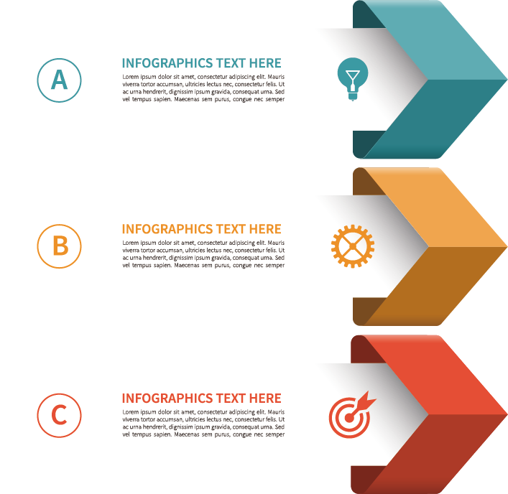



1704
Television Advertisement
Print Advertisement
Online Advertisement
Radio Advertisement

Slide 11
Television Advertising
About 60% of the customers are likely to purchase the things after seeing an add on Television Advertisement

Slide 12

Print ,Online and Social Media
Online 45%
Social Media 43%
Print Advertisements 42%

Slide 13
Radio and Billboards
Customers influenced by
31 % of Billboard advertisements
30% of Radio advertisements .

Slide 14
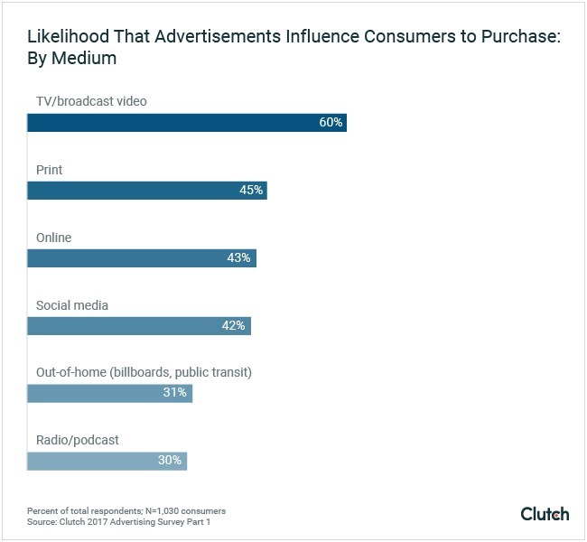
Impact of Mediums

Slide 15
Psychological techniques that influence buyers choice….

Slide 16
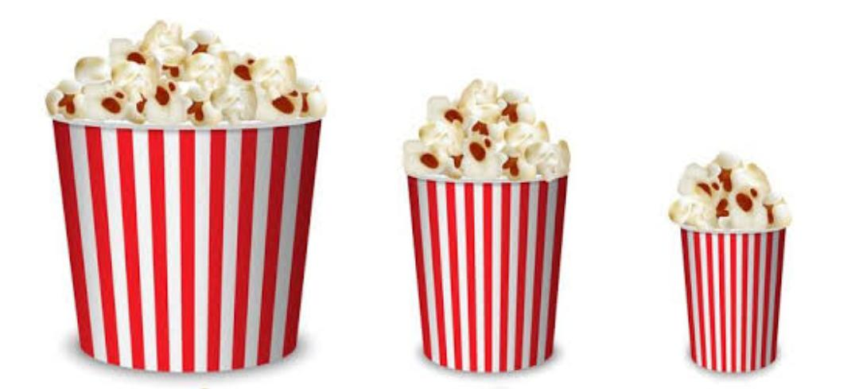
The Decoy Effect

Slide 17
The Illusion of Society
In Order for companies of sell product they need to create a sense of society for us to buy
For Some reason humans find something for more desirable if its only limited edition

Slide 18

Social Influence
Occurs when a person emotions ,opinions or behaviours effected by others
Same thing as peer pressure but just done on a wider scale

Slide 19
Principles of Advertising

Slide 20
Association Principle
A visual handsome
association principle is a type of advertising technique that “associates a product with an image”.

Slide 21
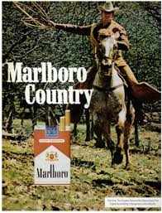
Association Principle
Association principle is a type of advertising technique that “associates a product with an image”.

Slide 22

Repetition Principle
Reusing of the same or similar elements throughout your design
Ufone-tum he to ho
Cocomo-mujai b do
Zong4g-A new dream
SurfExcel -dagh to achay hotay hain

Slide 23

Testimonial Principle
Using a well-known person to endorse a product.

Slide 24
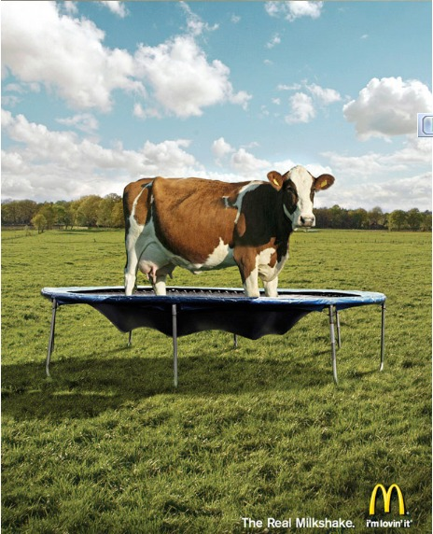

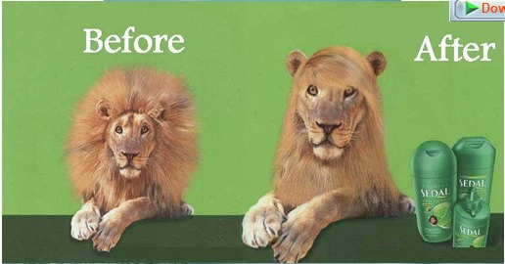
Humor Principle
The quality that makes something laughable or amusing; funniness

Slide 25


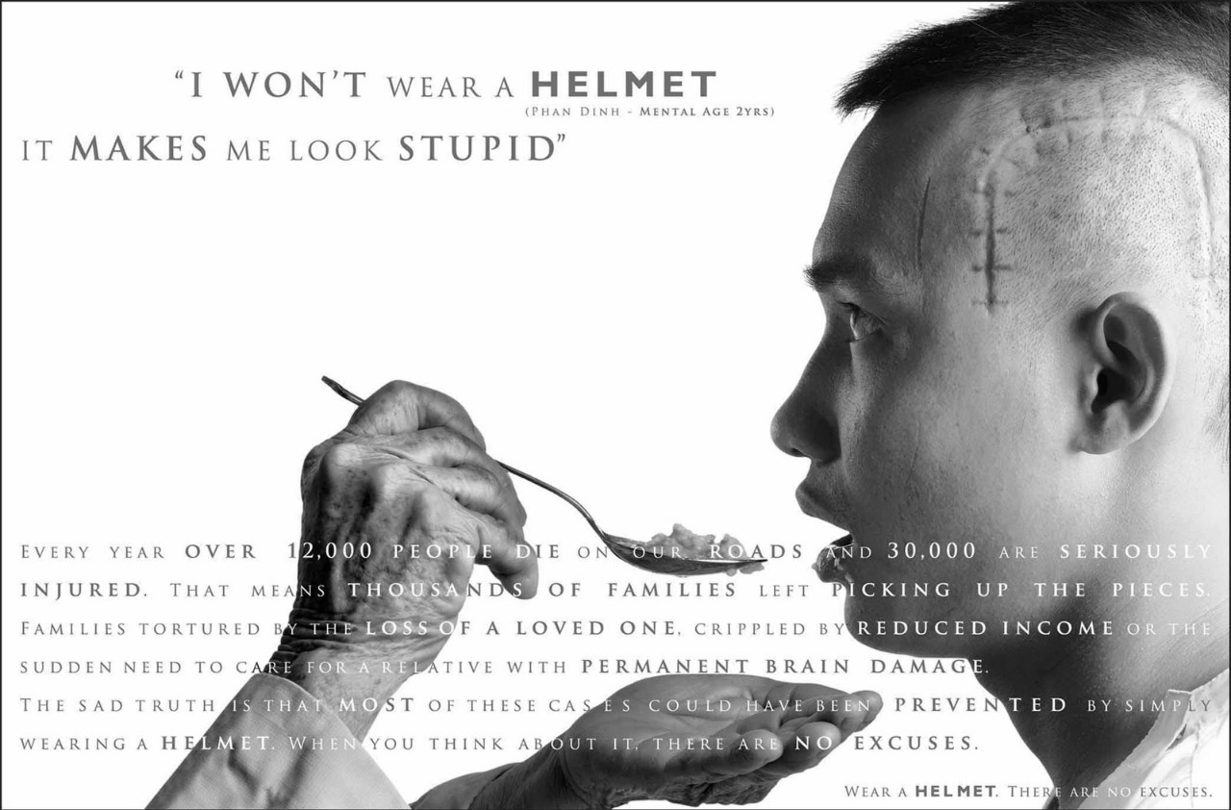
Fear Principle
Designed to scare the intended audience by describing a serious threat to them.

Slide 26

Advertising Good or Bad

Slide 27
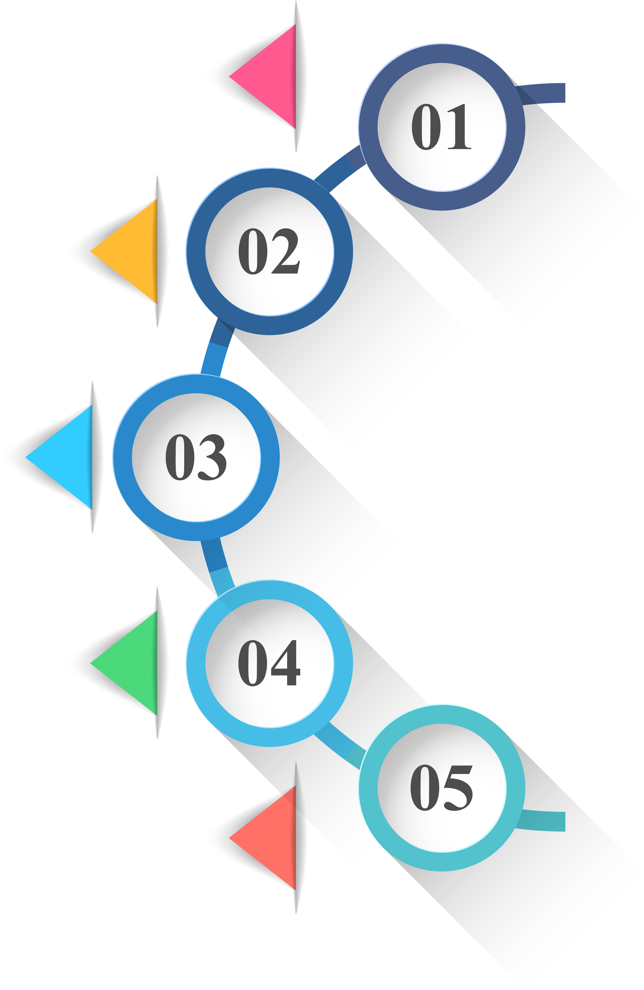
Advertisements
Makes Money
Introduce & Encourage People
No need for Shopping everyday
Give Latest Information about the product
Aim of the Manufacturer

Slide 28



Good aspects
Info. Of product
Helpful For Buyer
Helpful For Seller
No Shopping Every Day

Slide 29

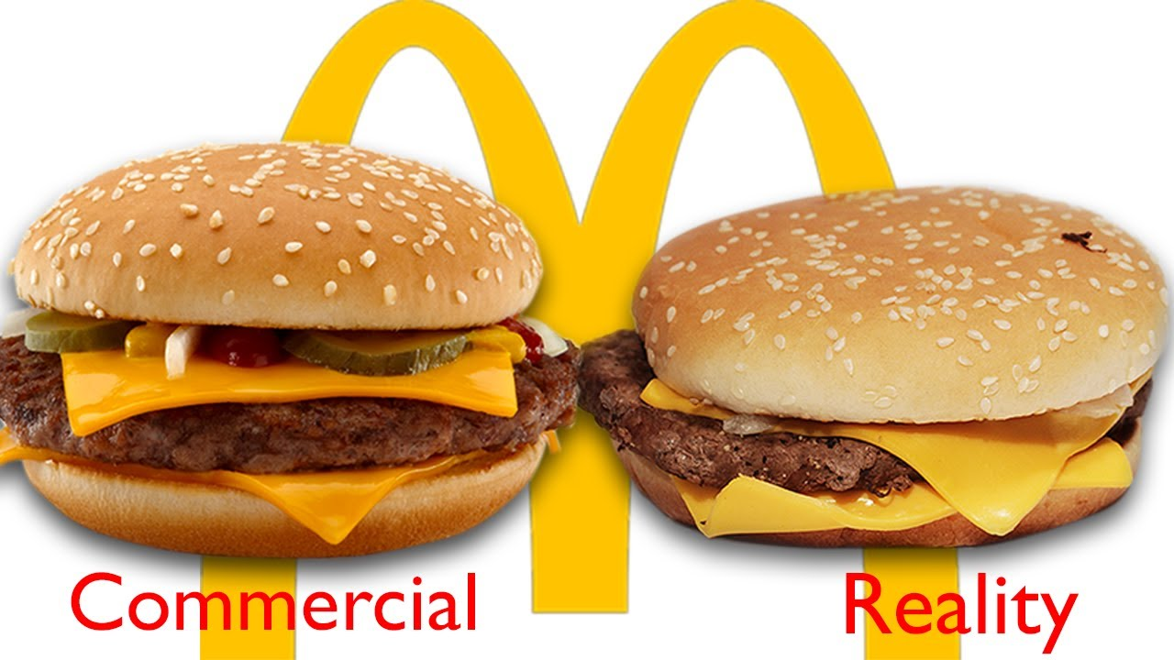
Bad aspects
Cheating on the people
False information of
the product

